Slide 1
Data Analysis and Decision Making
CHAPTER 14
14.1 Mathematics and Management
14.2 Basic Math and Measurement Systems
14.3 Understanding and Using Basic Statistics
14.4 Using Data in Decision Making

Slide 2
14.1 Mathematics and Management
GOALS
Describe ways that mathematics is used by managers to improve decision making.
Identify several common and specialized mathematical applications used by business managers.

Slide 3
Mathematics Skills for Managers
Math for decision making
Communicating findings

Slide 4
Business Applications of Mathematics
Developing Math Skills
Math Applications in Business
Accounting and Finance
Production and Operations
Marketing
Human Resources

Slide 5
Common Business Activities that Require Math Skills
ACTIVITY | DESCRIPTION
Calculate | Determine the quantity or value of something
Compare | Determine how two or more values vary from each other
Plan | Use data to set numerical goals or standards
Analyze | Review data to identify relationships, patterns, and explanations
Project | Use past and current information to estimate future performance

Slide 6
14.2 Basic Math and Measurement Systems
GOALS
Demonstrate understanding of basic mathematical operations.
Recognize common units of U.S. and metric measurement.

Slide 7
Basic Mathematic Operations
Adding and subtracting
Multiplying and dividing
Fractions, ratios, decimals, and percentages

Slide 8
Measurement Systems in Business
Traditional U.S. measures
Metric measures

Slide 9
14.3 Understanding and Using Basic Statistics
GOALS
Explain why statistics is important to managers and identify two types of statistics.
Recognize important types of statistical information.

Slide 10
Understanding Numerical Information
The importance of statistics
Types of statistics
Descriptive statistics
Inferential statistics

Slide 11
Statistics Terms and Concepts
Descriptive statistics
Inferential statistics

Slide 12
Common Descriptive Statistics
Range
Frequency distribution
Central tendency
Mean
Median
Mode

Slide 13
Common Inferential Statistics
Population
Sample
Probability
Correlation

Slide 14
14.4 Using Data in Decision Making
GOALS
Describe how to identify and communicate the results of data analysis.
Discuss how data should be used in effective decision making.

Slide 15
Communicating Results of Data Analysis
Completing data analysis
Summarizing results
Written summaries
Tables, charts, and graphs

Slide 16
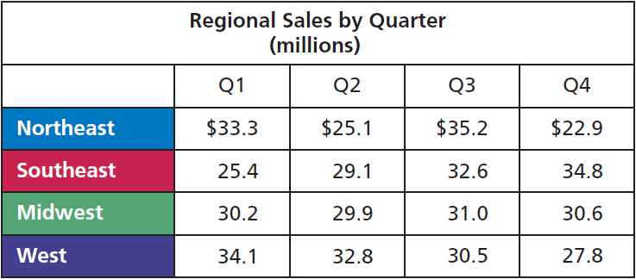
Example of a Table
© Cengage Learning 2013.

Slide 17
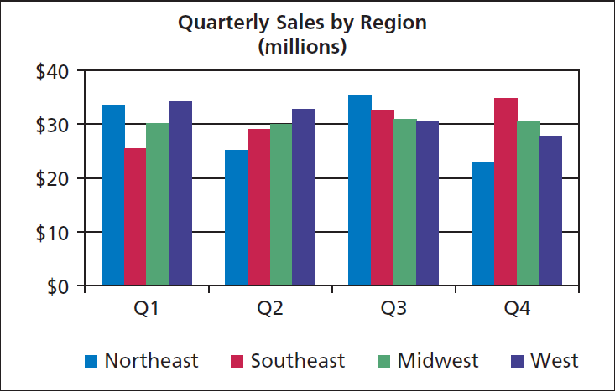
Example of a Chart
© Cengage Learning 2013.

Slide 18
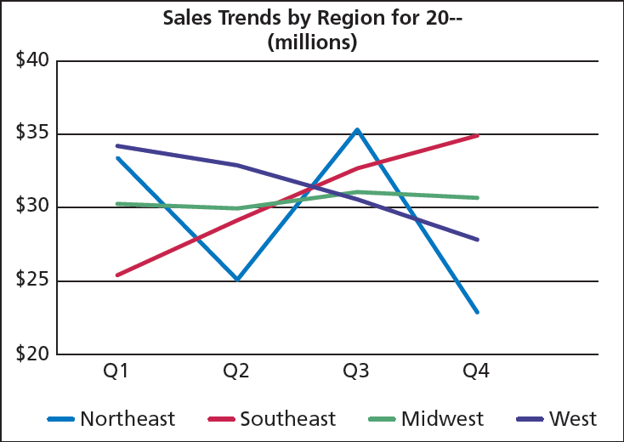
Example of a Graph
© Cengage Learning 2013.

Slide 19
Making Data-Based Decisions
Reading and interpreting information
Answering questions and solving problems

