Slide 1
Managing the Form of Business Ownership
CHAPTER 10
10.1 Entrepreneurs and Proprietorships
10.2 Partnerships
10.3 Corporate Forms of Business Ownership
10.4 Specialized Types of Organizations

Slide 2
10.1 Entrepreneurs and Proprietorships
GOALS
Describe the characteristics of successful entrepreneurs.
Evaluate the role of planning in managing your own business.
Explain the management issues of proprietorships.

Slide 3
Characteristics of Entrepreneurs
Entrepreneurs
Intrapreneurs

Slide 4
Planning a Business
Business plan
Forms of ownership
Proprietorships
Partnerships
Corporations

Slide 5
The Nature of Proprietorships
Management issues of proprietorships
Self management
Relationship management
Speed of decision making
Freedom from red tape
Liability
Businesses suited to proprietorship
Part-time proprietorships

Slide 6
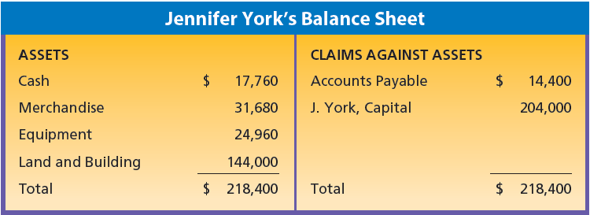
Balance Sheet for Proprietorship
© Cengage Learning 2013.

Slide 7
10.2 Partnerships
GOALS
Discuss the impact of partnerships on managing a business.
Explain the management issues of partnerships.

Slide 8
The Nature of Partnerships
Partnership—a business owned by two or more people.
Partnership agreement—a written agreement between two or more people identifying how the partners will add capital, labor, or other assets and divide any profits

Slide 9
Management Issues of Partnerships
Expanded management input
Capital
Efficiency
Tax advantages
Liability
Agreement between partners
Uncertain life
Division of profits

Slide 10
Limited Partnerships
Limited partnership—partnership with at least one general partner who has unlimited liability and at least one limited partner whose liability is limited to his or her investment.

Slide 11
Businesses Suited to Partnership
More than one kind of product or service
More than one location
Extended operating hours
Professional services

Slide 12
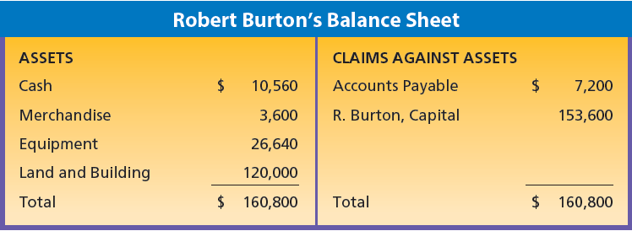
Balance Sheets for Proprietorships
© Cengage Learning 2013.
© Cengage Learning 2013.

Slide 13
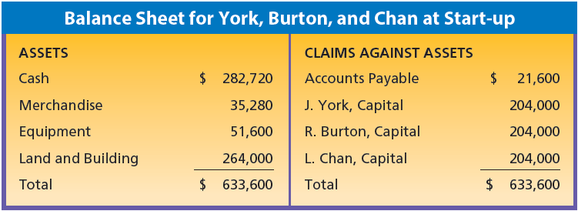
Balance Sheet for a Partnership
© Cengage Learning 2013.

Slide 14
10.3 Corporate Forms of Business Ownership
GOALS
Explain the basic structure of a corporation.
Describe how a corporation is formed and organized.
Explain the management issues of corporations.

Slide 15
The Structure of Corporations
Basic features
Stockholders
Directors
Officers
Close and open corporations

Slide 16
Formation of Corporations
Preparing the certificate of incorporation
Stating the purpose of the business
Investing in the business
Paying incorporation costs
Operating the new corporation
Getting organized
Handling voting rights

Slide 17
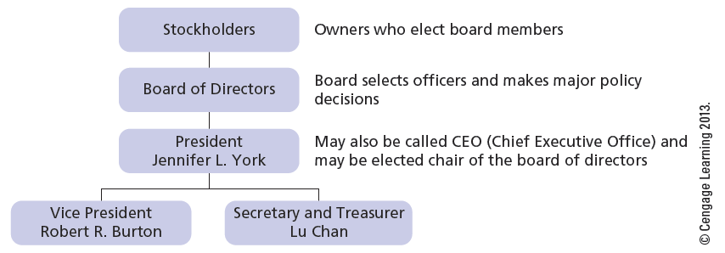
Organization Chart for a Corporation

Slide 18
Management Issues for Corporations
Sources of capital
Limited liability
Permanency of existence
Ease in transferring ownership
Taxation
Government regulations and reports
Stockholders’ records
Charter restrictions
Agency dilemma

Slide 19
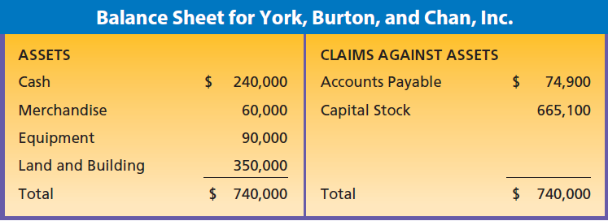
Balance Sheet for a Corporation
© Cengage Learning 2013.

Slide 20
10.4 Specialized Types of Organizations
GOALS
Describe organizations that are specialized alliances between companies or individuals.
Describe specialized forms of corporations formed for tax or nonprofit reasons.

Slide 21
Organizational Alliances
Limited liability partnerships
Joint ventures
Cooperative

Slide 22
Specialized Forms of Corporations
Limited liability company (LLC)
Nonprofit corporations
Quasi-public corporations

